Slide 1

Introducing the
Collaboration for International Development Economics Research (CIDER)
Prof. Chris Barrett
Faculty Director, CIDER
Cornell Reunions alumni seminar
June 5, 2026

Slide 2





Cornell has longstanding preeminence in development economics.
Expertise cuts across Colleges on campus.
January 2024 – CIDER (soft) launched as joint venture of four colleges, led by SC Johnson College of Business.
Encompasses 28 faculty across 8 Departments and 5 Colleges.

Slide 3
Promote impactful faculty research
Weekly gatherings for faculty, post-docs, students and staff
Development economics research seminars
Weekly CIDER teas
Monthly CIDER brownbag lunch discussions
Events for foster collaborative research w/prospective partners
Annual CIDERFest to showcase faculty research
Workshops w/Catholic Relief Services (fall 2024), International Food Policy Research Institute (fall 2025)
CDSES/Atkinson Thought Summit on Data Science to Build Resilience and Improve Humanitarian Response (spring 2026)
Host NEUDC 2026 annual conference (fall 2026)
Sponsored Research Lead
- Ph.D. staff member to scope and facilitate grant proposals.

Slide 4
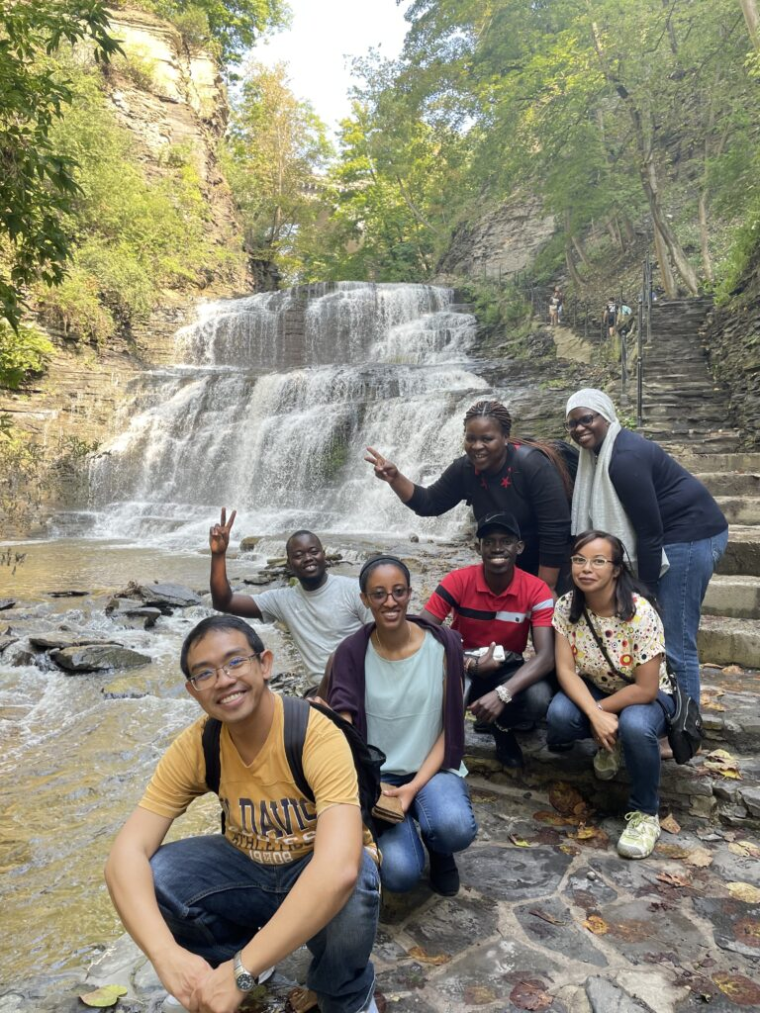

Nurture early career scholars
STARS Fellows Program
Since 2016, 93 early career Fellows from Global South, mentored by Cornell faculty.
Big, measurable impacts on future research productivity and impact.
Partner w/African Development Bank, Center for Global Development, World Bank
Pre-doctoral Research Fellowships
7 to date (1 new in July), supporting faculty research. Top Ph.D. program placements.
Student Internships
- International Rescue Committee, IFPRI

Slide 5
We welcome partners for research projects, internships, etc.
And your support. Please look for CIDER on Giving Day 2027 ☺
Just reach out to:
CIDER@cornell.edu or chris.barrett@cornell.edu

